Slide 1
MIS 321
Deploying

Slide 2
Deploying
There are many ways to deploy our apps ranging from setting up our own server to using a cloud provider like Azure or AWS.
For our project, we are going to use a common cloud based service with a free tier called Heroku
Navigate to heroku.com and sign up for the free service

Slide 3
Deploying the Client Side
Recall we broke our code into two major parts. The client side HTML/CSS/Javascript that will run in the browser and the backend / server side C# code.
We will deploy them as two separate apps keeping them independent of each other.
On Heroku, navigate to “new” and choose “Create new app”

Slide 4

Deploying the Client Side
Give your app a simple name such as book-app and click Create app

Slide 5
Deploying the Client Side
Before we deploy our code, we do need to make a minor change.
Heroku only supports a limited number of app types
Oddly enough static html/css/javascript is not supported natively
We are going to add 2 files to our client side code to trick Heroku into thinking our project is a PHP app
In your root Client folder (same folder that has index.html) create a file called composer.json . It’s only entry should be {} on line 1.
In the same folder create a file called index.php. It should have the following in it:
<?php include_once("index.html"); ?>

Slide 6
Deploying the Client Side
We will take advantage of github to deploy our code
Create a repo of just the client folder
Push that repo to a github repo to be used in the deployment

Slide 7
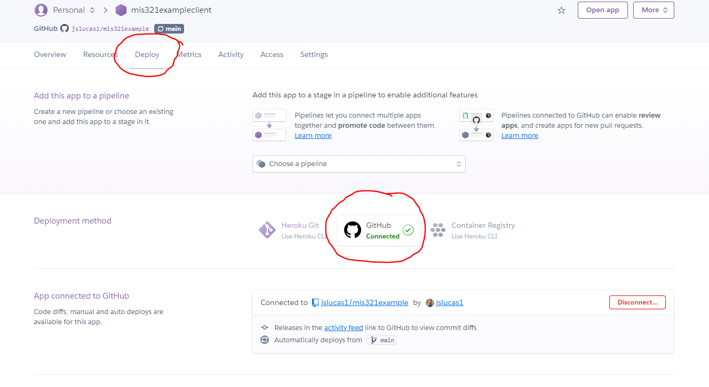
Deploying the Client Side
On the Deploy tab of your app, click the GitHub button in the Deployment method section.
Search for your client repo and connect the app to the GitHub Repo

Slide 8
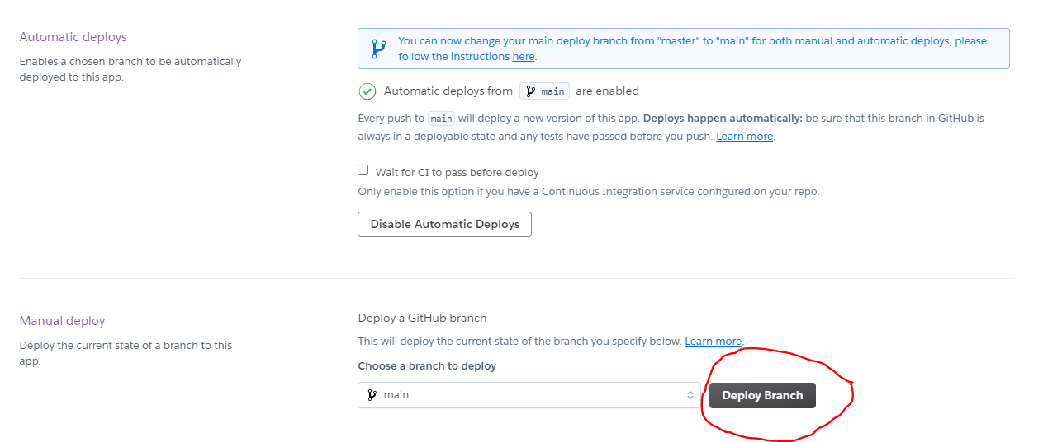
Deploying the Client Side
Click Deploy Branch in the Manual deploy section. Watch to ensure there are no errors.
You can also enable auto deployments every time you push to GitHub.

Slide 9
Deploying the Server Side
Many of the steps for deploying our server side code will be the same, so let’s knock them out.
Create a new Heroku app
Init, commit and push just the API folder contents to a new github repo
Connect this new repo to the server side app you have created
Before we hit the deploy button there are a few things we need to take care of.
Heroku does not support dotnet core apps natively
Heroku does not support SQLite

Slide 10
Deploying the Server Side
Adding the dotnet core build pack.
While Heroku does not support dontet core, an open source build pack has been created that we can use. We just need to tell Heroku to use it
Under the settings tab for your app, in the Buildpacks section, add the following script
https://buildpack-registry.s3.amazonaws.com/buildpacks/jincod/dotnetcore.tgz

Slide 11
Deploying the Server Side
Moving to a hosted database solution
SQLite was great in development. For production we need to move to something more robust
I thought this would be a good opportunity to separate our data from our business logic and create a classic 3 tier architecture
Start by picking a provider. I used freemysqlhosting.net and created a MySQL database

Slide 12
Deploying the Server Side
Moving to a hosted database solution
Next, pick a RDMS. I used the online phpmyadmin tool, but you can use what you are familiar with.
Connect to the table using the credentials provided by your service provider
Create your table
Depending on your RDMS you may need to use sql to update the id column to be auto incrementing
ALTER TABLE yourTableName
MODIFY yourColumnName INT NOT NULL AUTO_INCREMENT;
Add some data to your table

Slide 13
Deploying the Server Side
Next we need to update our project to use MySql instead of SQLite
Add the MySql packages
dotnet add package mysql
dotnet add package mysql.data
Add the using statements
using System.Data;
using MySql.Data;
using MySql.Data.MySqlClient;

Slide 14
Deploying the Server Side
Next we need to update our project to use MySql instead of SQLite
Update the connection string
string cs= "server=<?>;user=<?>;database=<?>;port=<?>;password=<?>";
Update the connection
MySqlConnection con = new MySqlConnection(cs);
Update Sql commands
MySqlCommand cmd = new MySqlCommand(stm, con);

Slide 15
Deploying the Server Side
Commit and push these changes to github. Ensure the auto deploy worked or manually deploy on Heroku.
Update the url for the backend inside your javascript to route to the new deployed api.
Commit and push the front end to github. Ensure the auto deploy worked or manually deploy to Heroku.
Time to fully test!!!!

